Slide 1
E WEB Creators
PHASE 2
CSP-584
Enterprise Web Application
Parth Patel A20405581
Krunal Sevak A20405875
Pradyot Mayank A20405826

Slide 2
Overview
Submit Requirements
Wait For Approval & Get Quote
Get Live Project Status
Make Payment
Ready to Deploy!

Slide 3








High Level Model
BDO
PM
Admin
Client
Request
Approved/Reject
Approved/Reject
Accept/Reject
MySQL Databse
Project Details
Write Suggestions
Project Details, Registration, Project Table
View Suggestions
Client

Slide 4

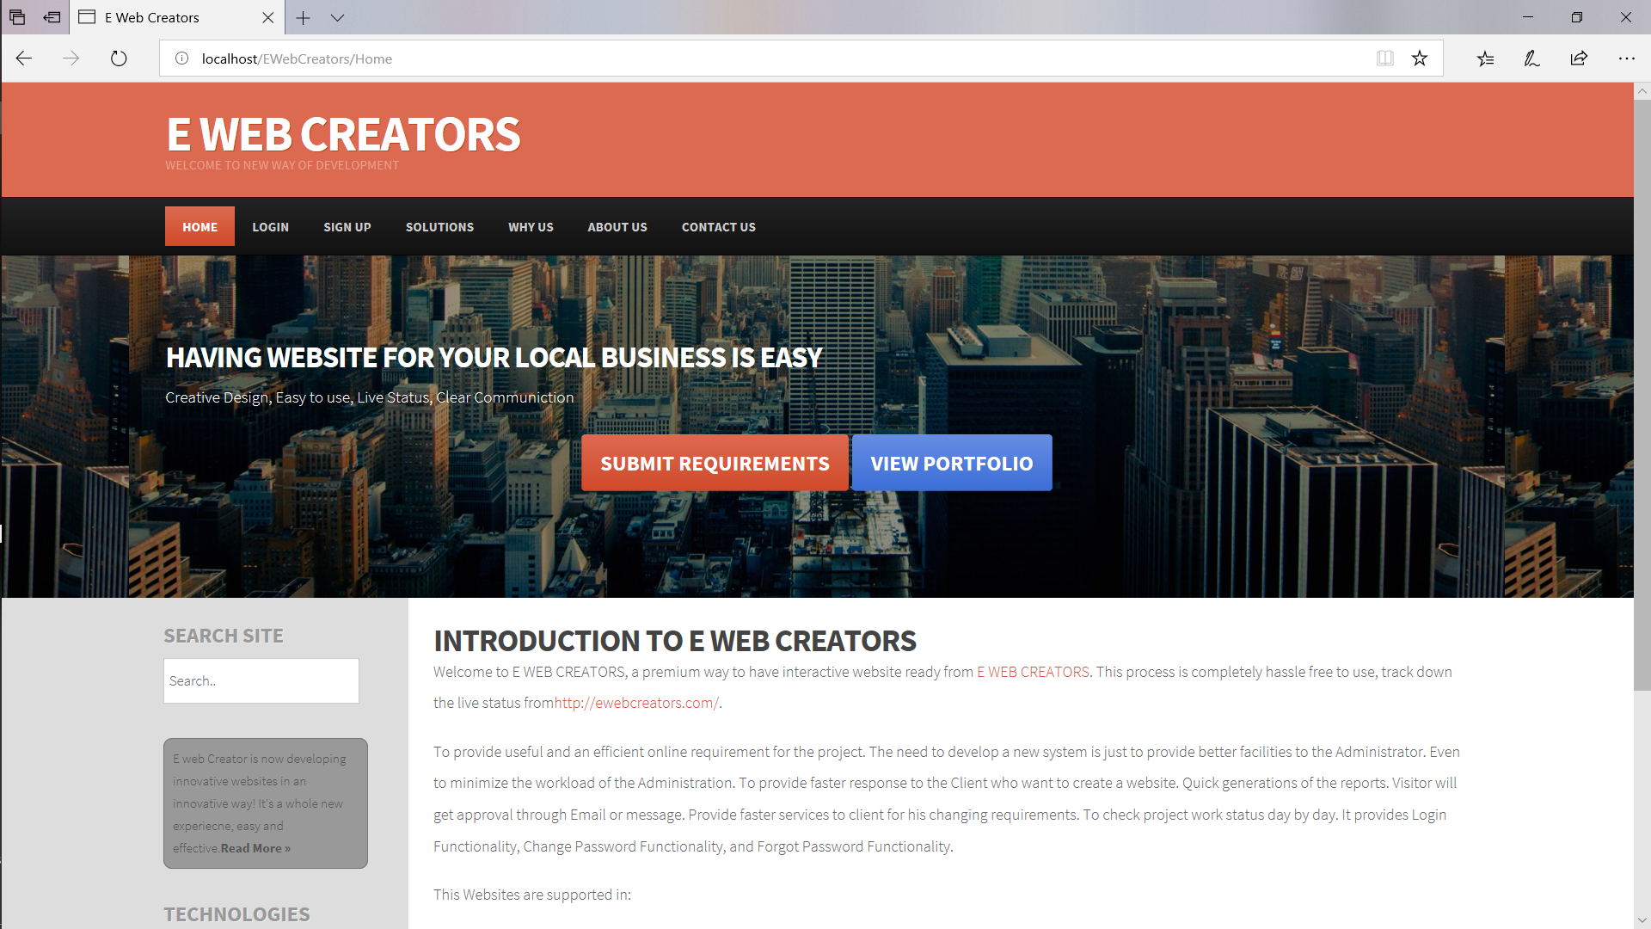
Home Page

Slide 5
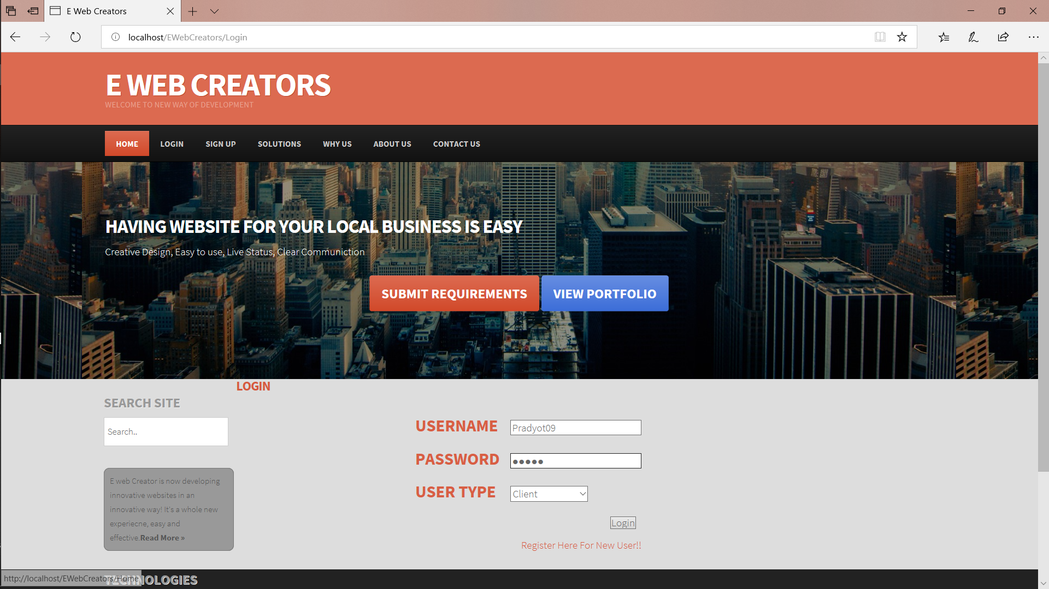
Login Page

Slide 6
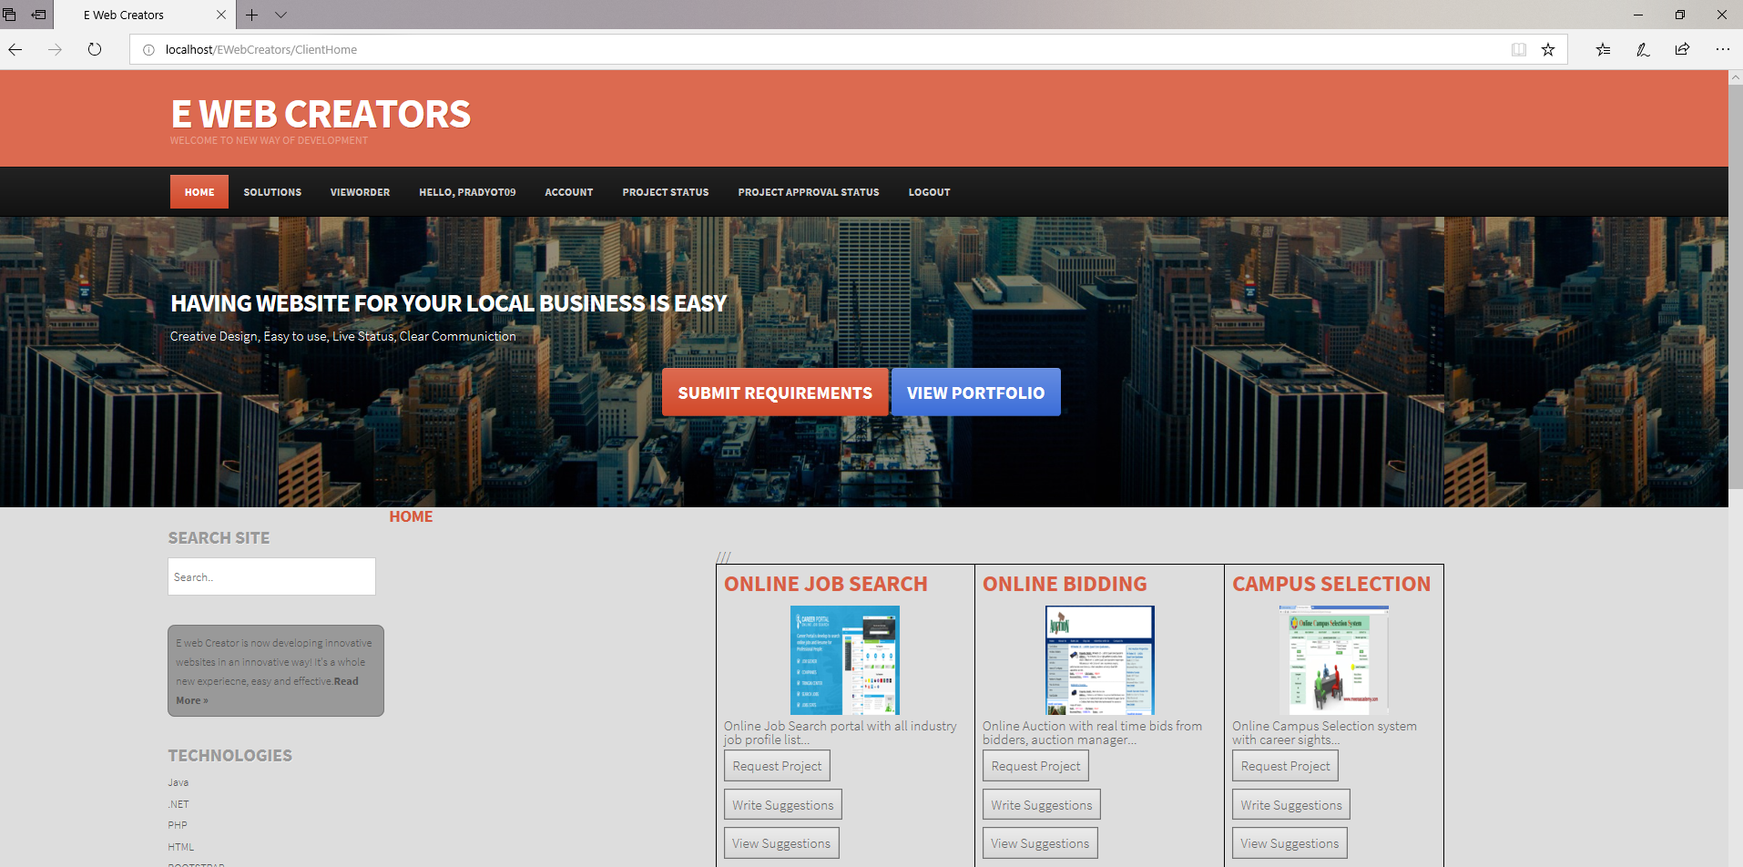
Client Home Page

Slide 7
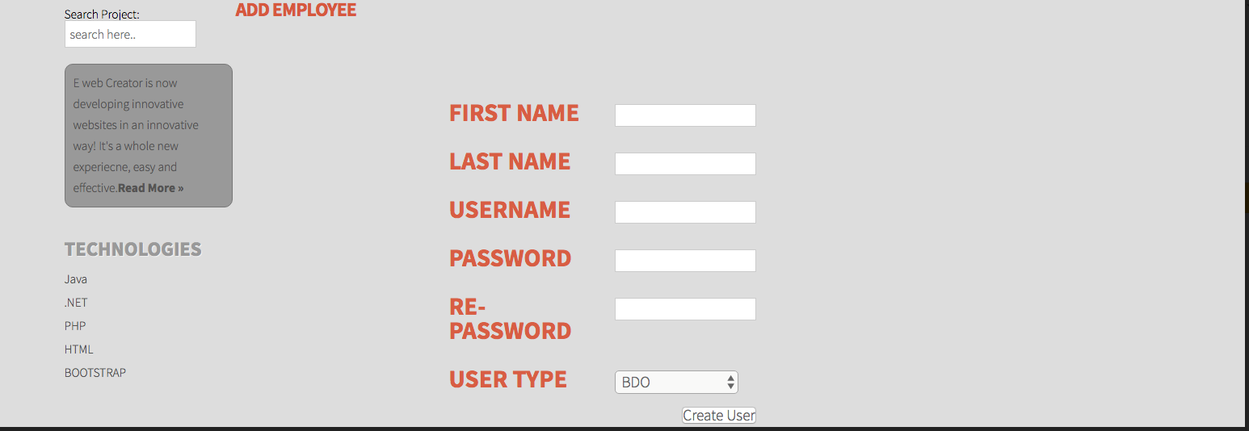
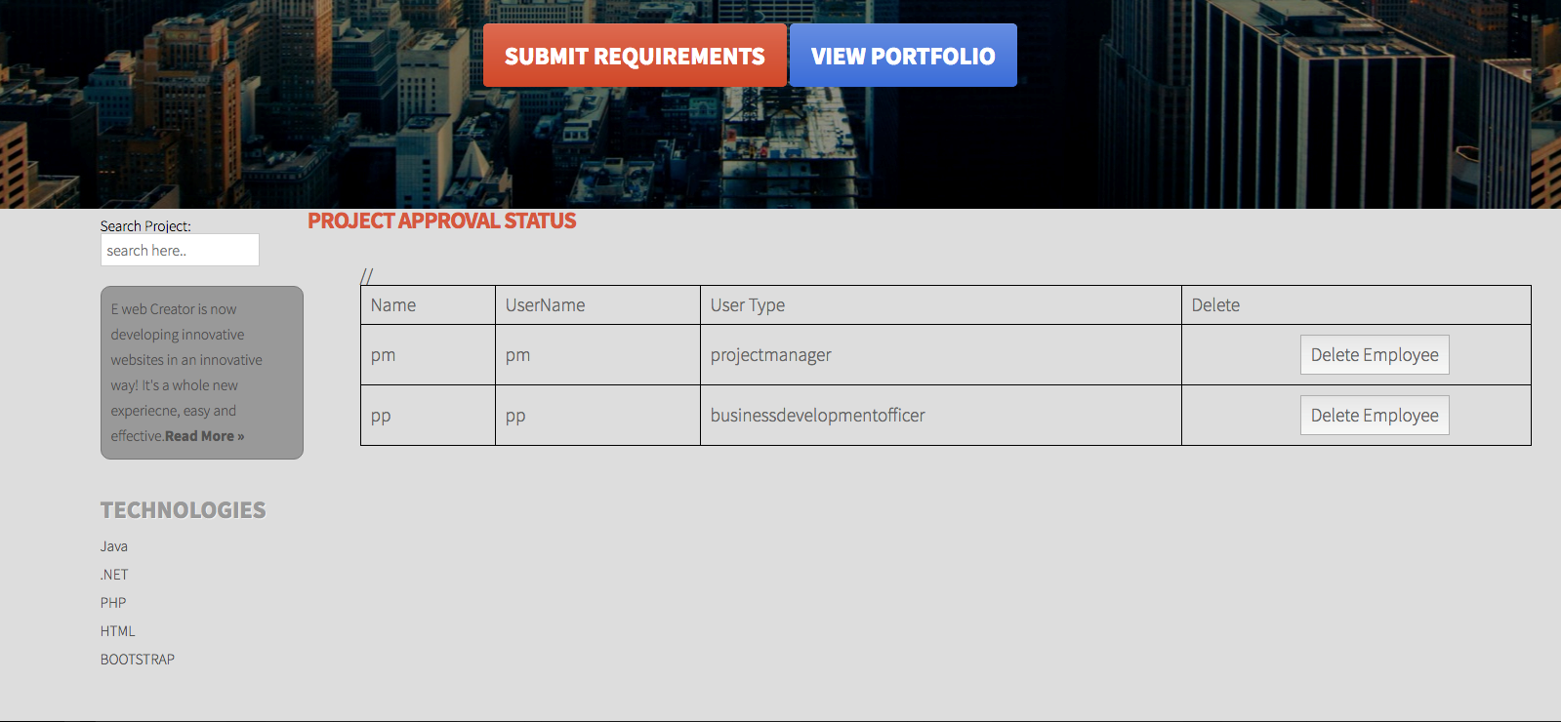
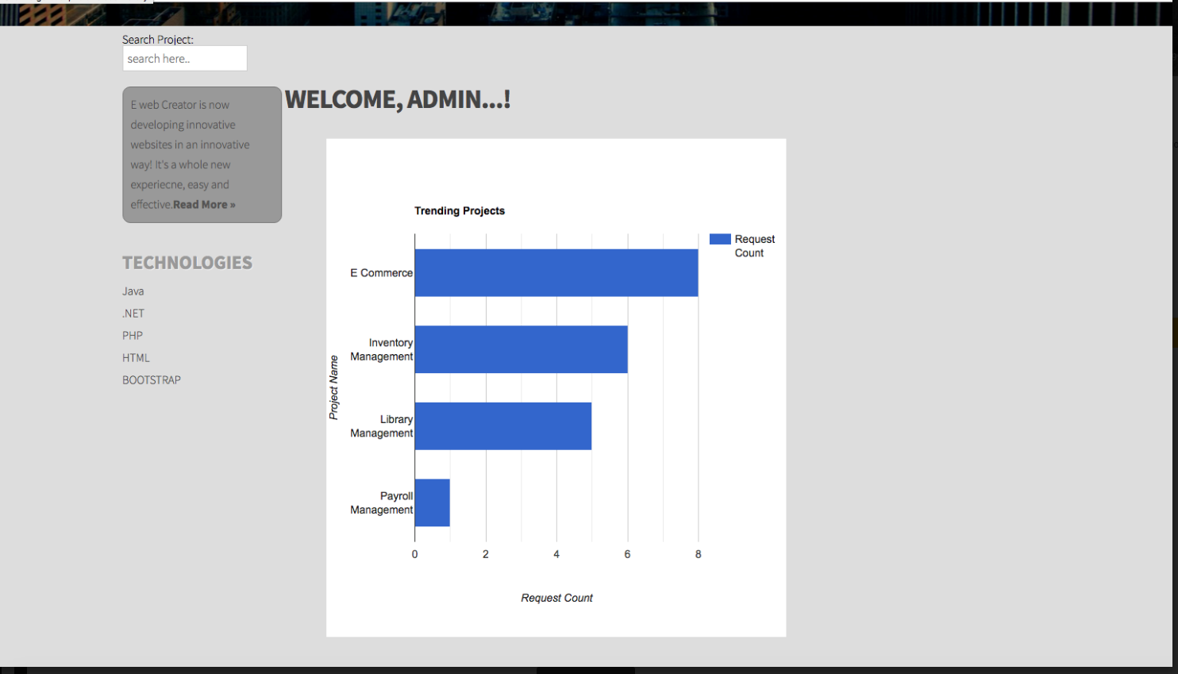
Admin Home Page

Slide 8
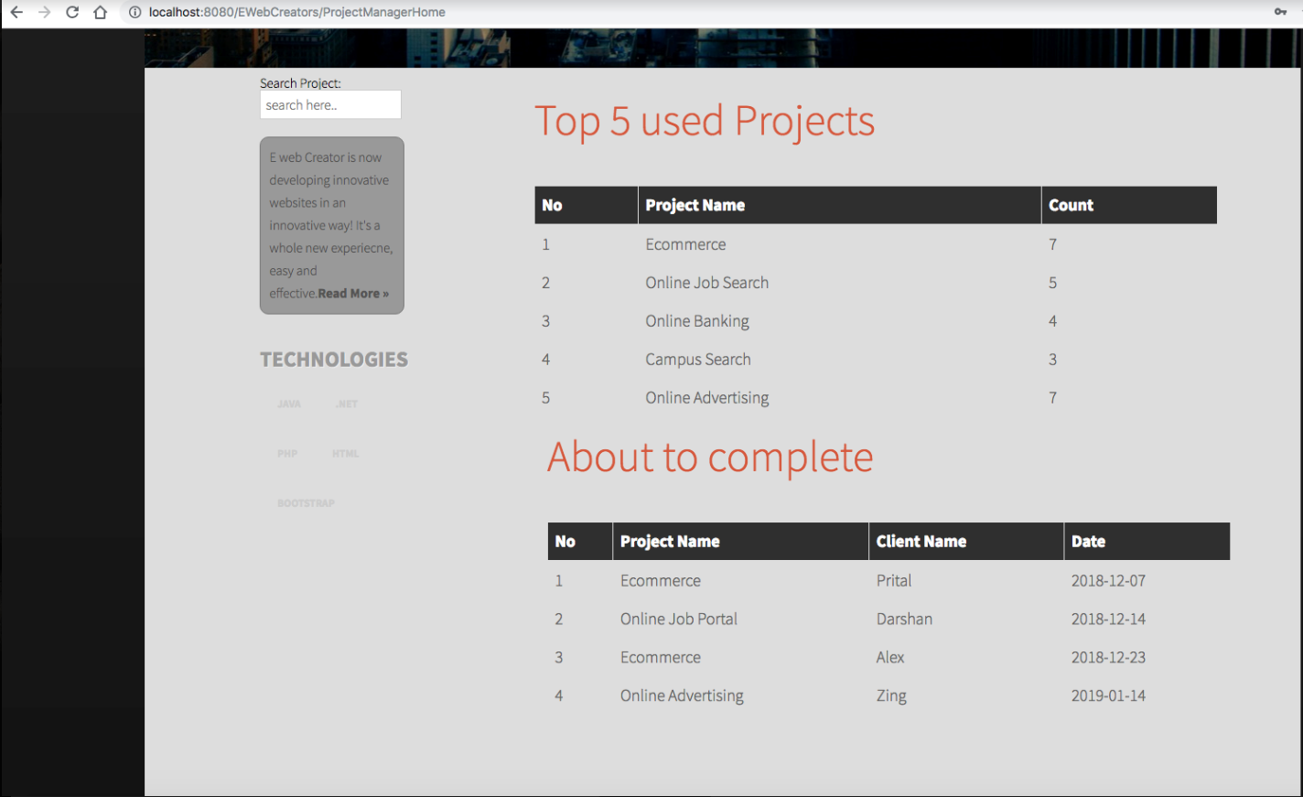
Project Manager Home Page

Slide 9
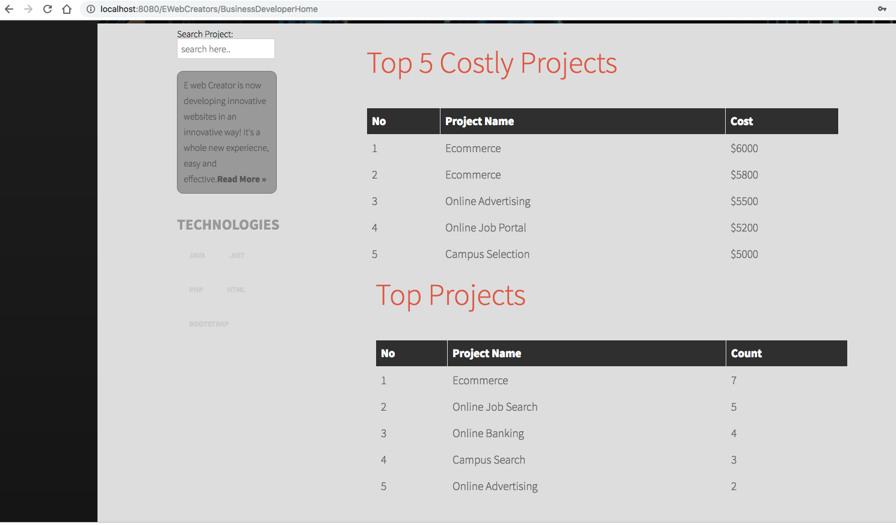
Business Developer Home

Slide 10
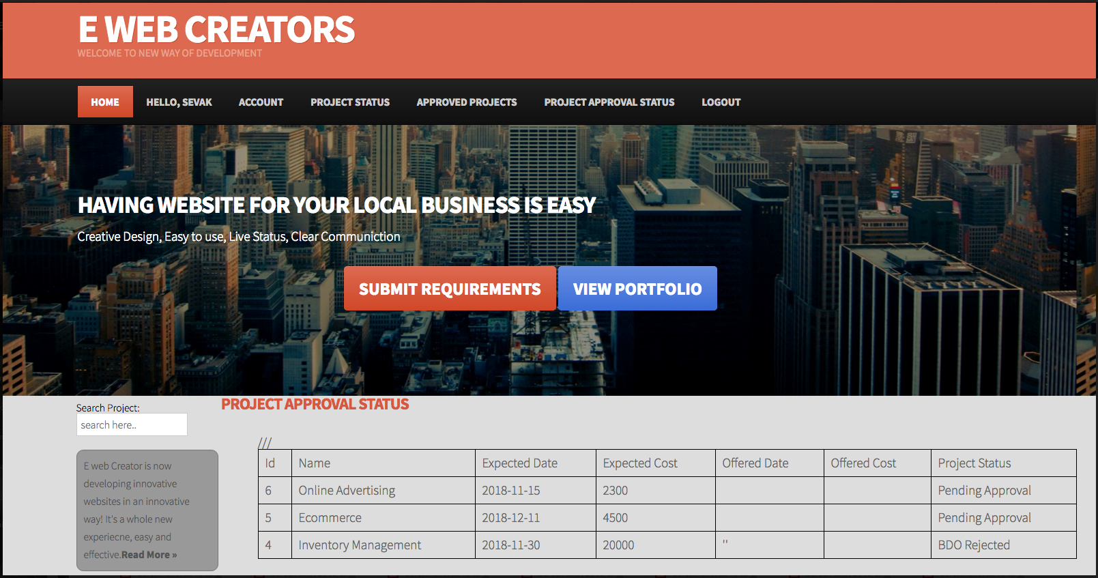
Project Approval Status Page

Slide 11
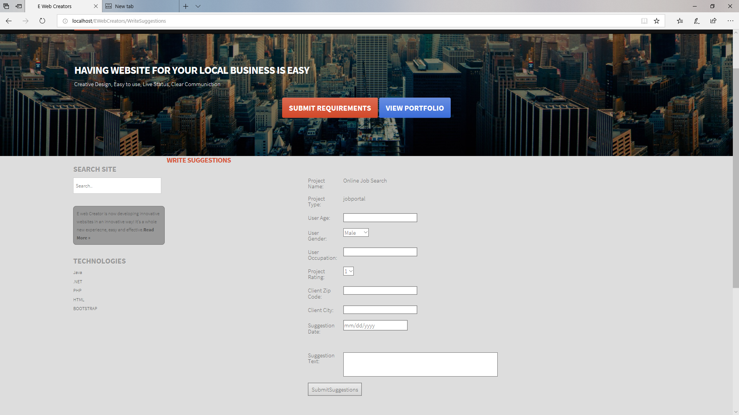
Write Suggestions Feature

Slide 12
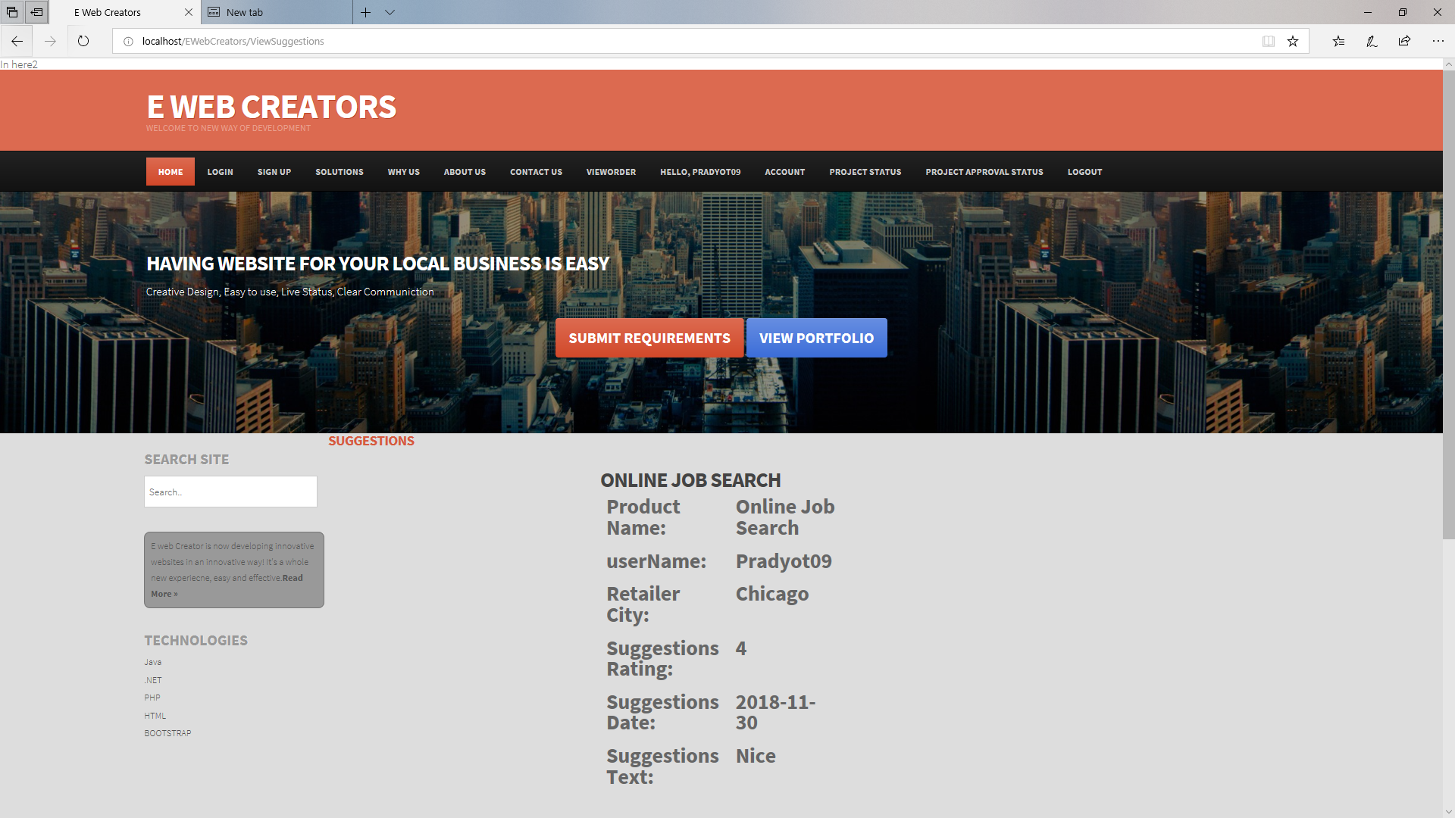
View Suggestions Feature

Slide 13
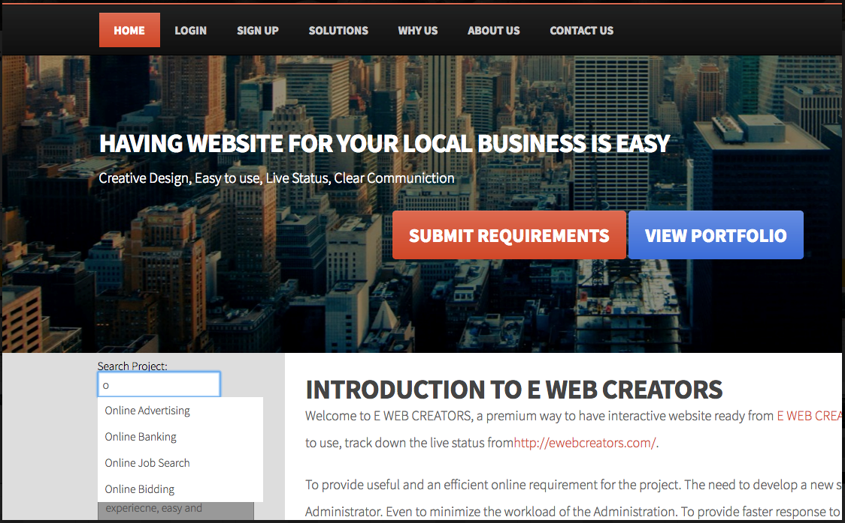
Search Feature

Slide 14
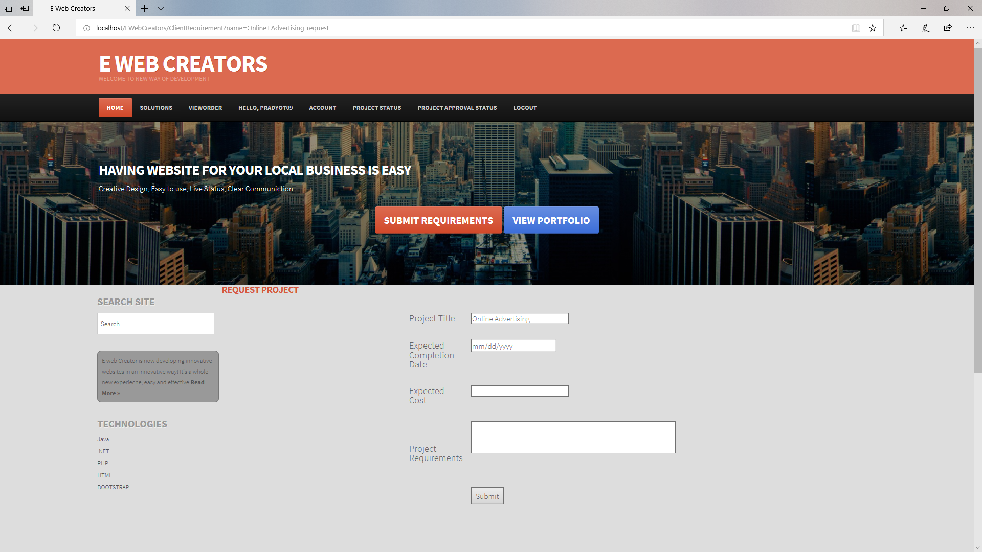
Request Project

Slide 15
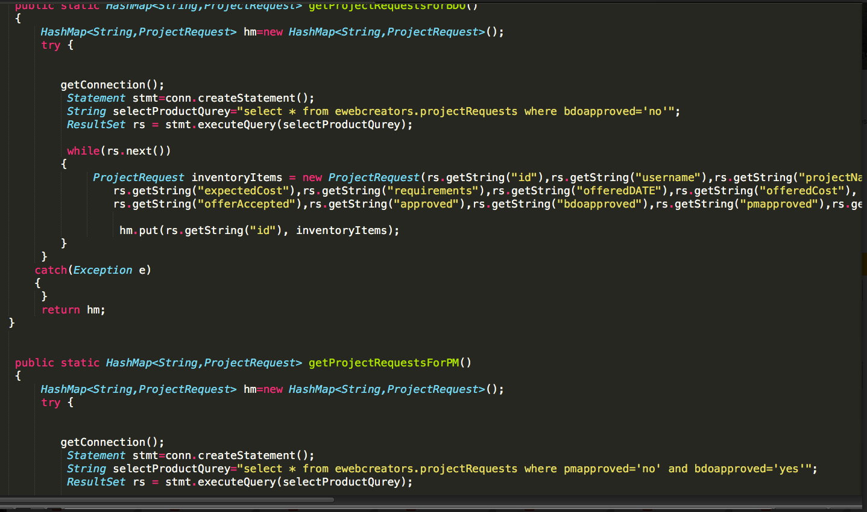
Code Snippet of Project Request Function PM And BDO

Slide 16
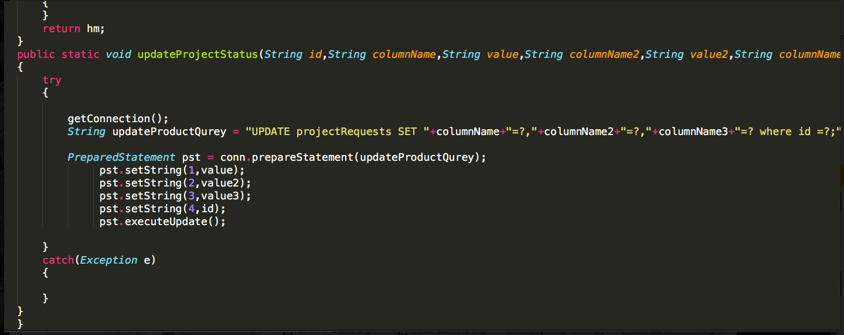
Update project Status Code Snippet

Slide 17
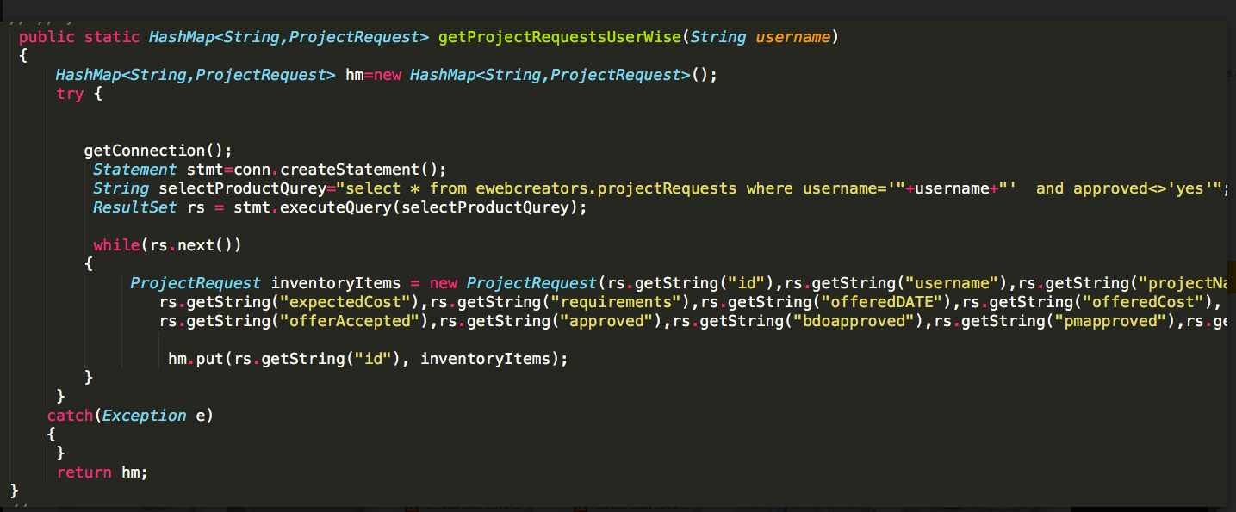
Project Request User Wise Code Snniepet

Slide 18
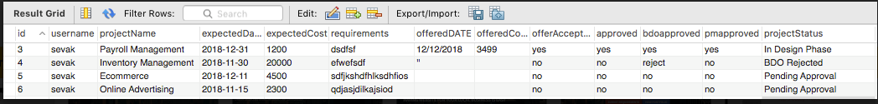
MySQL Project Details Tables

Slide 19
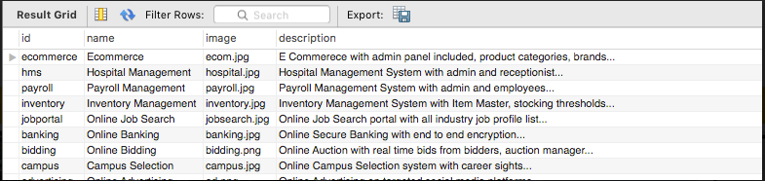
MySQL Product Details table

Slide 20
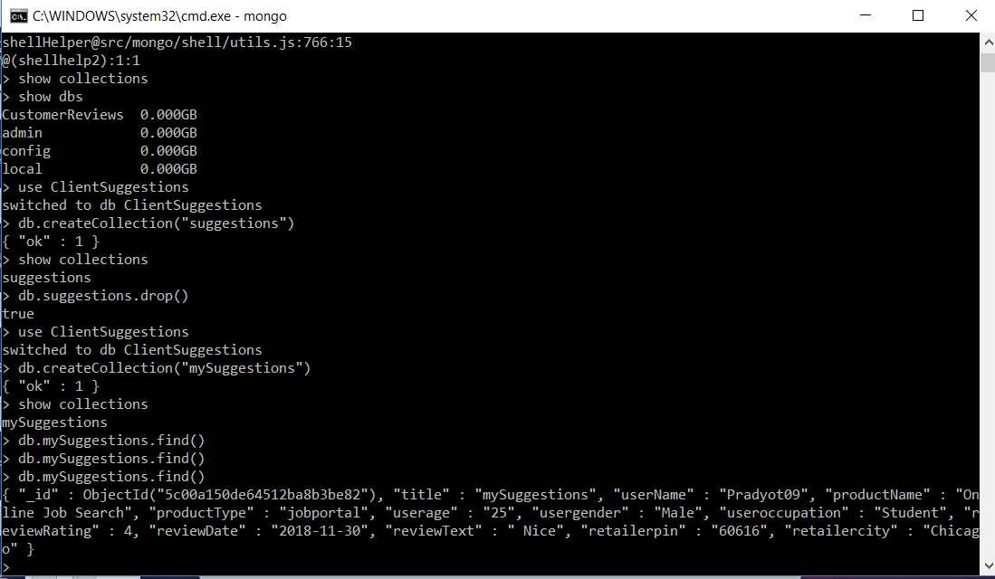
MongoDB for Suggestions

Slide 21
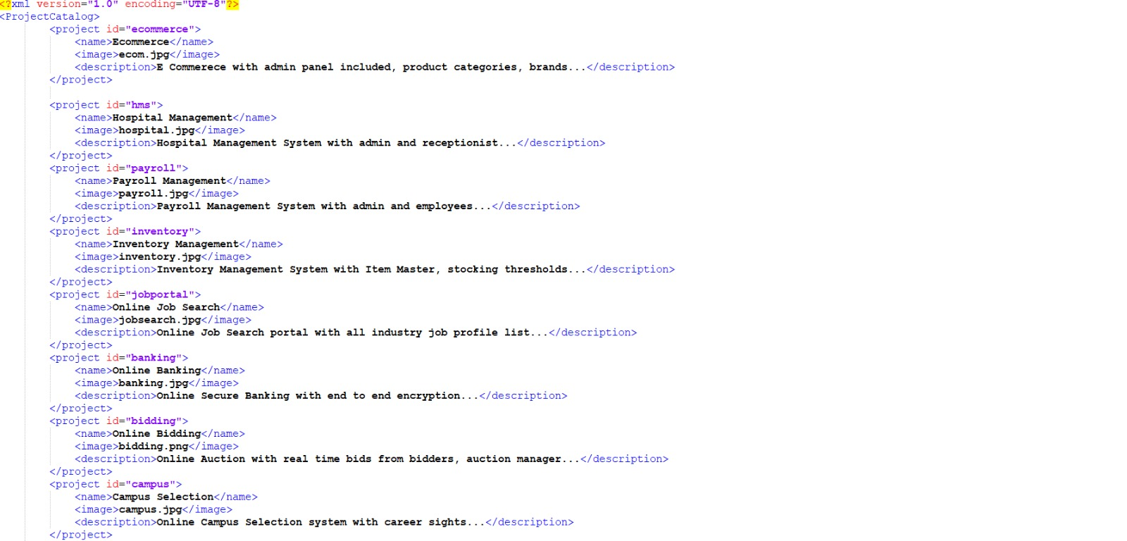
XML for Projects

Slide 22
Thank You
Questions?

